Slide 1
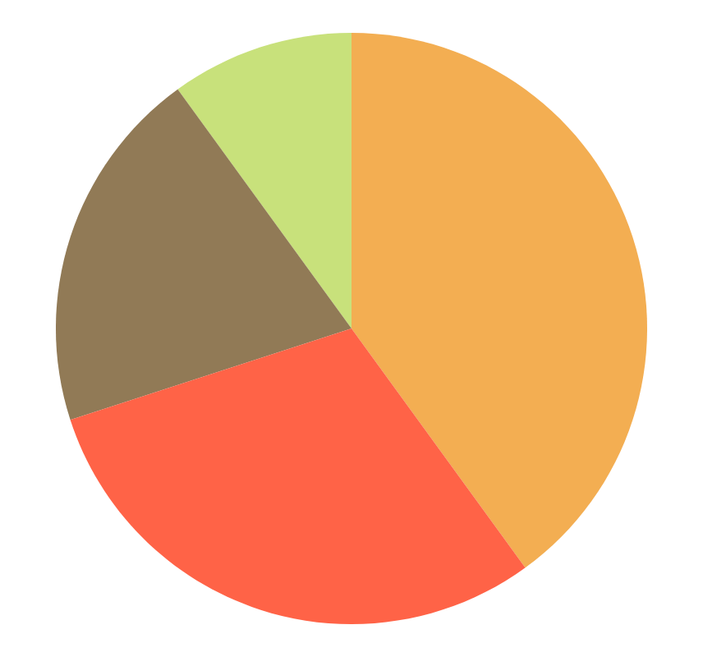
Restaurant Sales Analysis
BY Mariyum Baig

Slide 2
Introduction
This project analyzes restaurant sales data to gain insights into customer
spending patterns, popular menu categories, and order trends. The dataset consists of multiple tables, including:
order_details:
Contains order-wise item purchases.
menu_items:
Provides information on food items, including their
prices and categories.

Slide 3
Questions For Analysis:
View the menu_items table and write a query to find the number of items on the menu?
What are the least and most expensive items on the menu?
How many Italian dishes are on the menu? What are the least and most expensive Italian dishes on the menu?
How many dishes are in each category? What is the average dish price within each category?

Slide 4
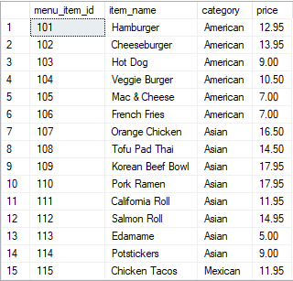


View the menu_items table and write a query to find the number of items on the menu?

Slide 5
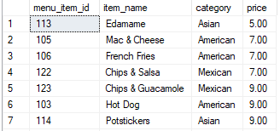
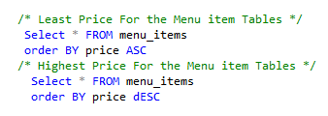
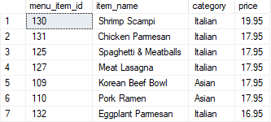
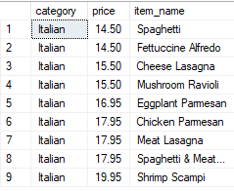
What are the least and most expensive items on the menu?

Slide 6
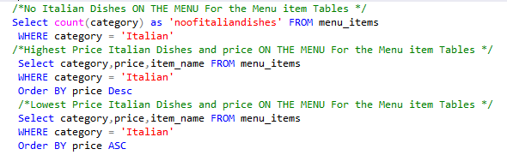

How many Italian dishes are on the menu? What are the least and most expensive Italian dishes on the menu?

Slide 7
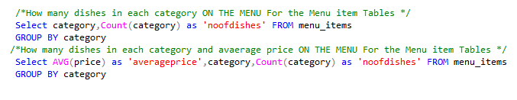
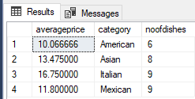
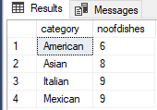
How many dishes are in each category? What is the average dish price within each category?

Slide 8
Questions For Analysis:
View the order_details table. What is the date range of the table?
How many orders were made within this date range? How many items were ordered within this date range?
Which orders had the most number of items?
How many orders had more than 12 items?

Slide 9
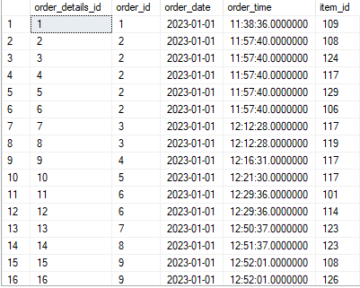
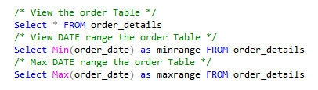


View the order_details table. What is the date range of the table?

Slide 10
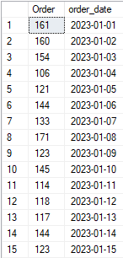
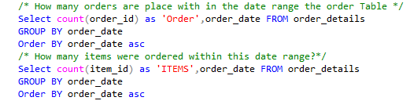
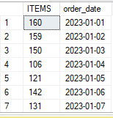
How many orders were made within this date range? How many items were ordered within this date range?

Slide 11
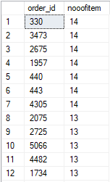

Which orders had the most number of items?

Slide 12


How many orders had more than 12 items?

Slide 13
Questions For Analysis:
How can we combine the menu_items and order_details tables into a single table?
What are the least and most ordered items? Which categories do they belong to?
Which 5 orders had the highest total spend?
What details can be gathered about the highest spend order (Order ID: 440)?
What insights can be derived from the top 5 highest spend orders? (Order IDs: 440, 2075, 1957, 330, 2675

Slide 14
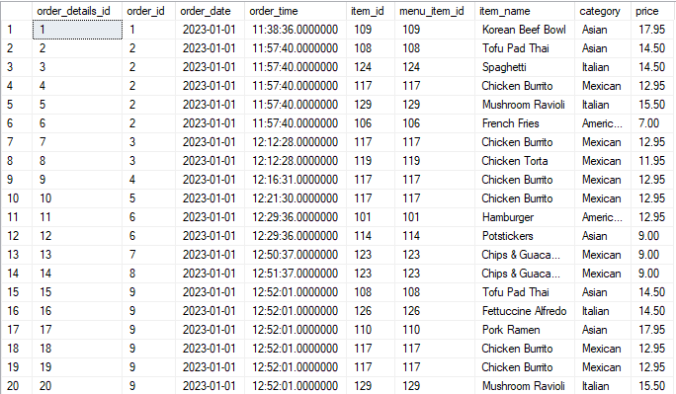
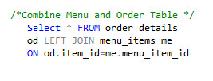
How can we combine the menu_items and order_details tables into a single table?

Slide 15
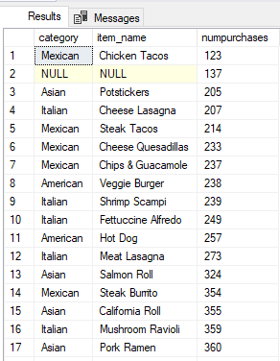
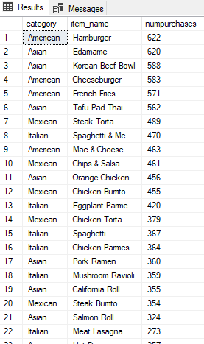
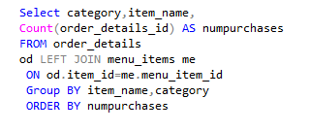
What are the least and most ordered items? Which categories do they belong to?

Slide 16
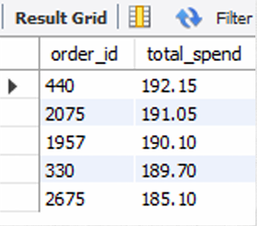
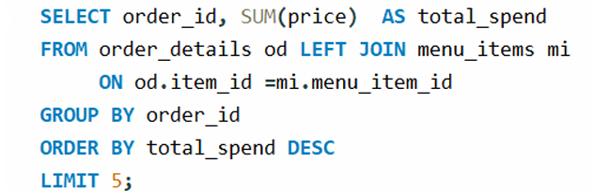
Which 5 orders had the highest total spend?

Slide 17
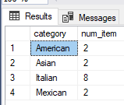
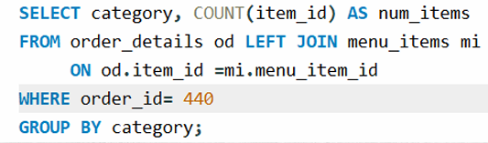
What details can be gathered about the highest spend order (Order ID: 440)?

Slide 18
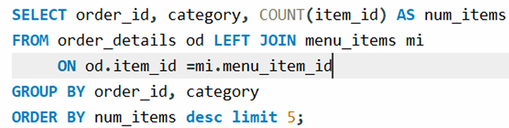
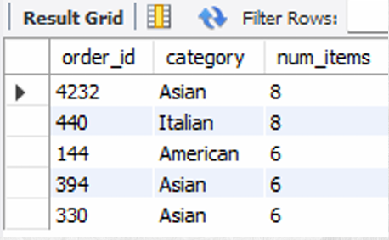
What insights can be derived from the top 5 highest spend orders? (Order IDs: 440, 2075, 1957, 330, 2675

Slide 19
Thanks

